Slide 1


Sabrina I Queipo Efrain Nava*
PERSONALIZED MEDICINE: BLOOD PRESSURE AND HEART RATE MONITORING IN WEARABLE DEVICES
Phase I
* Aggregate Professor at the University of Zulia, Maracaibo, VE
February 2020

Slide 2

Outline
Objective
Motivation
Methodology
Case studies
Deliverables

Slide 3

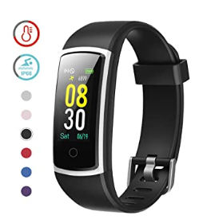
Objective
Through wearable devices effectively monitor (ambulatory) blood pressure and heart rate for preventing heart disease and predicting cardiovascular events and complications¹
Ambulatory blood pressure monitoring (ABPM) measures blood pressure at regular intervals. It is believed to be able to reduce the so called white coat hypertension
1 The heart rate monitor is based on a technology called photoplethysmography, but it basically comes down to using green LED lights paired with light‑sensitive photodiodes to illuminate your skin and measures changes in light absorption.

Slide 4
Motivation
According to the World Health Organization (WHO), heart diseases are the Nº 1 cause of death globally… and in the US
It costs the nation about $207 billion each year in health care services, medications, and lost productivity
Wearables gives the unique opportunity to monitor and generate alerts/alarms tailored to the cardiovascular risk level of each individual²
2 For example, African americans are known to have higher levels of office blood pressure (BP) and prevalence of hypertension than whites

Slide 5
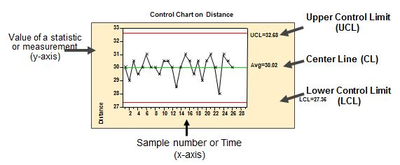
Methodology
The baseline approach is based on statistical process control theory and includes:
Identify the individual thresholds (Hi and Hi-Hi alarms) for systolic and diastolic heart blood pressure (including variability), and heart rate under different scenarios (e.g., day/night, awake/sleep, normal/exercising) — random variables time series
Compute basic statistics for each of the time series of interest and normalize them (for radar visualization). Using the corresponding charts identify the deviations of the random variables of interest with respect to the specified threshold
…

Slide 6
Methodology
The baseline approach is based on statistical process control theory and includes: (cont.)
…
Generate reports for the Hi (UCL and LCL — threshold yellow) and Hi-Hi (threshold red) alarms including number of times where the alert/alarms were generated and cumulative time in alarm modes for specified time periods (day/week/month/year) and correlate the thresholds with cardiovascular outcomes

Slide 7
Case studies
+
The developed algorithm will be tested using the IDACO³ database, which has been the main influence for recommending ambulatory BP thresholds in the current hypertension guidelines. It includes data from general population studies in Denmark, Belgium, Sweden, and Japan
3 IDACO — The International Database of Ambulatory Blood Pressure in relation to Cardiovascular Outcome

Slide 8

Deliverables & Schedule
Deliverable | Expected completion date
Literature review. In particular, identify cardiovascular events, risk factors, and guidelines for heart blood pressure and heart rate from American College of Cardiology and American Heart Association. Specified the corresponding Hi and Hi-Hi alarm thresholds | March 15th
Code in Python. Input: time series associated to the random variables of interest. The code normalize, statistically monitor and correlate them with cardiovascular outcomes. Output: number and duration of each of the Hi and Hi-Hi alarms, radar visuals and correlations with cardiovascular outcomes | April 30th
Verification report | May 15th
Testing on case studies report | June 15th
Technical report (with results and discussion) | June 30th

